Slide 1
Product Contact Surface Sanitation for Direct Marketing CSA Session: Hershey, PA
Meredith Melendez
Rutgers NJAES Cooperative Extension of Mercer County

Slide 2
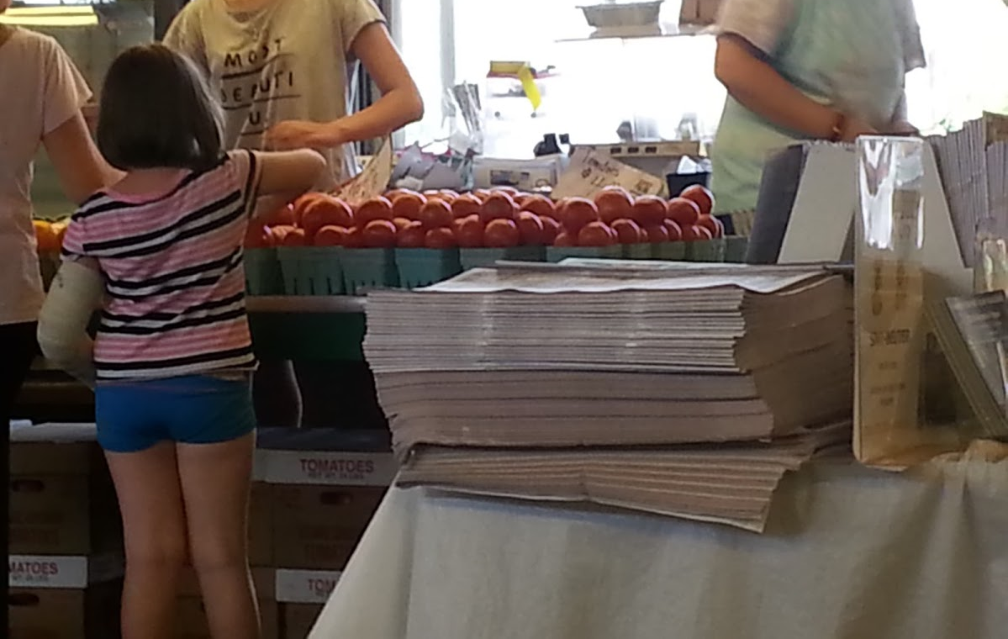
Notes:
There are many opportunities for produce and produce contact surfaces to become contaminated with human illnesses. Direct market channels of sales pose many unique situations for contamination, and can be incredibly specific to the farm itself. In this picture a young girl touches tomatoes that are likely to be consumed raw. Her hands pose a risk, her cast poses a risk, the paper containers pose a risk. Additionally the farm stand workers also poses a risk, and her actions from produce display to sale all impact the final quality of the tomatoes sold. There are often many points to consider in each situation.

Slide 3
What surfaces need cleaning and sanitizing?

Slide 4
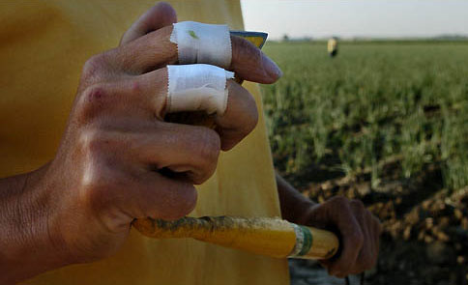
Notes:
Worker health and hygiene training should be given at the start of each season, and repeat trainings may be needed throughout the season. Workers hands and clothing can be source of contamination. Training must include information on human pathogens, how they can be spread, and how they are a necessary part of reducing that risk.

Slide 5
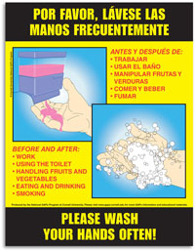
Notes:
Signage, with pictures, is an important way of reminding workers on how they can reduce risk.

Slide 6
Notes:
Worker health and hygiene training should be given at the start of each season, and repeat trainings may be needed throughout the season. Workers hands and clothing can be source of contamination. Training must include information on human pathogens, how they can be spread, and how they are a necessary part of reducing that risk.

Slide 7
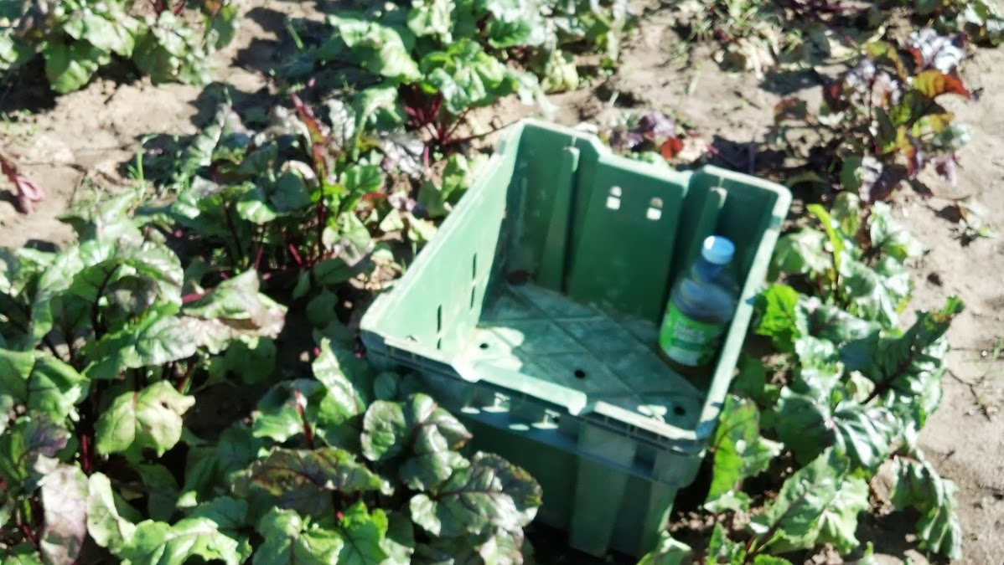
Notes:
Harvest bins should be made of material that is easy to clean and sanitize. These bins should only be used for harvesting, and in this case should not be used for holding personal belongings. This juice container could harbor human disease picked up at another location which could then be transferred directly to the produce, or onto the interior of the harvest bin and then onto the produce.

Slide 8
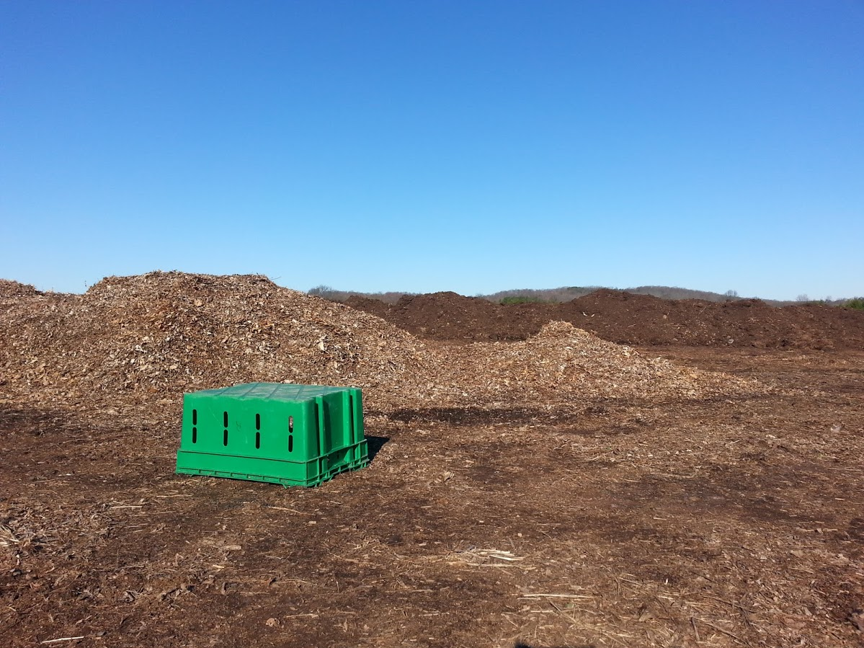
Notes:
This harvest bin was found in the compost production area of the farm. There is potential here for the harvest bin to become contaminated with human pathogens from animal manures used in the composting process. Harvest bins that become damaged may be used for other tasks, but should be marked as such so they do not end up back into contact with produce.

Slide 9
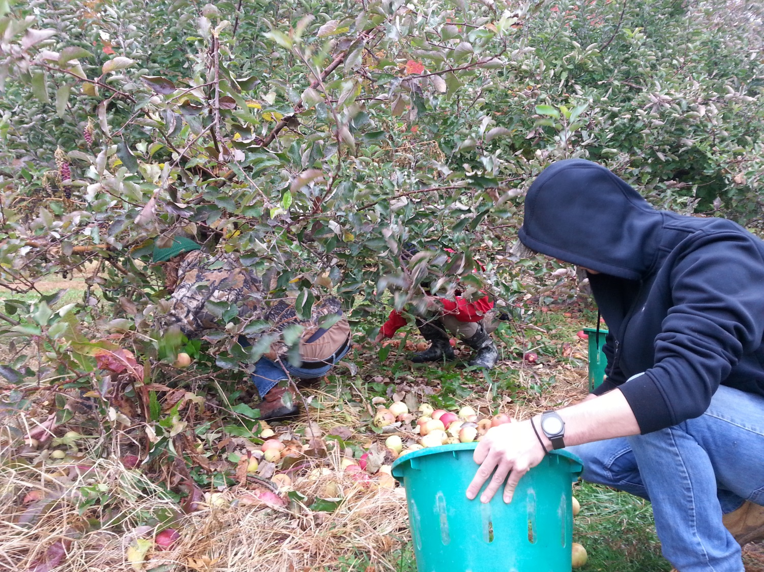
Notes:
Produce that falls to the ground should not be harvested. This is an issue for gleaning activities. Gleaned apples should not be provided for raw consumption, but may be used for further processing or cooking. Gleaned produce is often fed to populations who may be immuno-compromised, and at greater risk for illness and death.

Slide 10
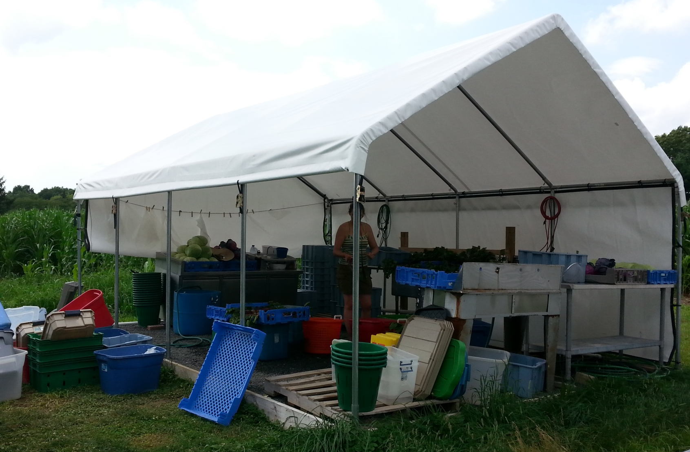
Notes:
Temporary packing areas are acceptable, if they are constructed with food safety in mind, the product contact surfaces are cleanable and ponding of water is not an issue in the area.

Slide 11
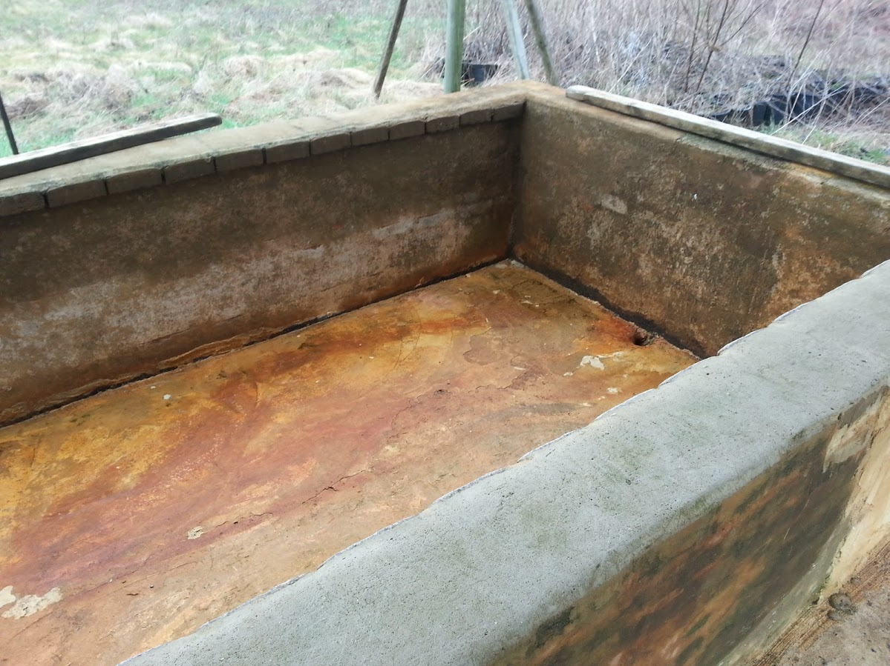
Notes:
Containers used to cool and/or wash produce must be able to be cleaned and sanitized on a regular basis. This cement covered brick wash bin shows wear and tear, flaking cement, and cracks and crevices that make sanitation difficult. Additionally zero generic E. coli water (EPA method 1603 lab test) must be used for any and all post harvest activities where the water has the potential to come in contact with the produce.

Slide 12
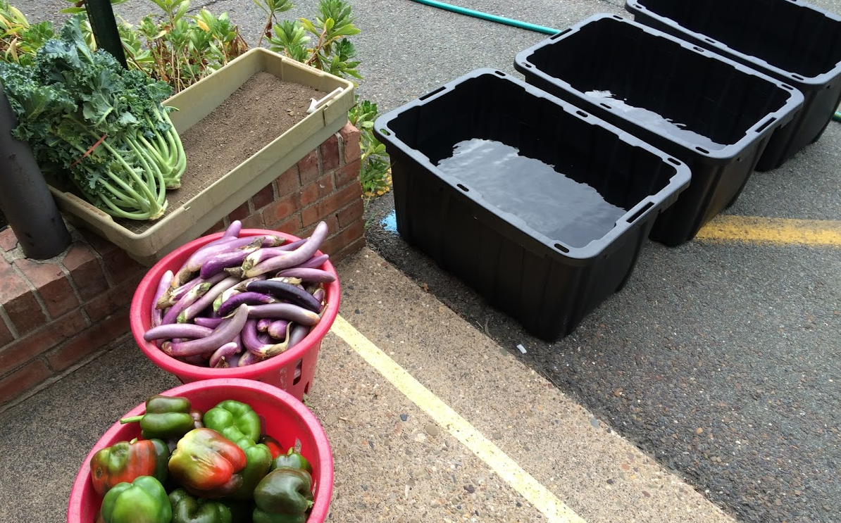

Slide 13
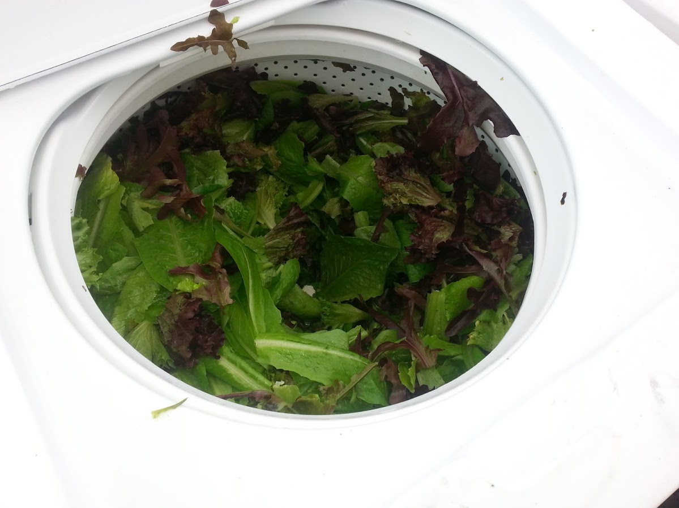
Notes:
This is a washing machine that is used for drying of lettuce leaves. While this can be an accepted practice care should be taken to 1. take a part the machine to better understand water flow through it (there can be filters inside that could harbor human pathogens) 2. understand the potential for biofilms to form if the equipment is not properly cleaned and sanitized 3. monitor for rodent activity (inside of a washing machine is a nice safe place for rodents to store and consume food!)

Slide 14
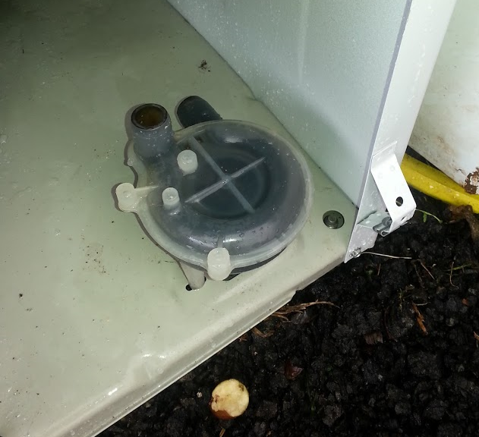
Notes:
This is an example of a filter inside of a washing machine. The filter can harbor and provide a breeding ground for human pathogens. Also notice the half eaten potato, brought into the washing machine by a mouse.

Slide 15
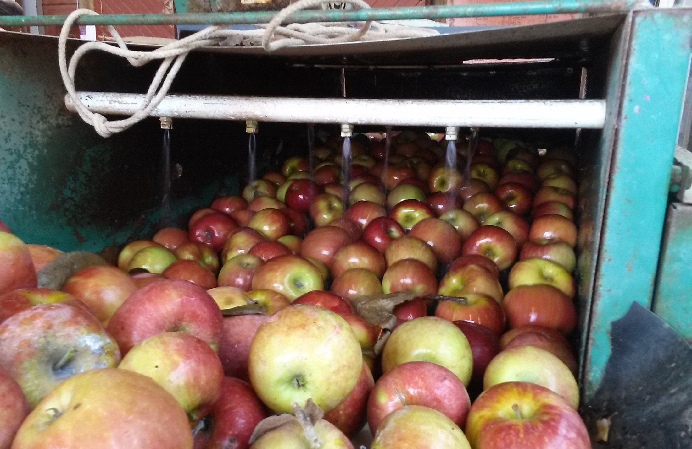
Notes:
Wash lines and dunk tanks are also considered product contact surfaces and should be included in your cleaning and sanitizing activities. Often equipment is re-used or old and can be difficult to clean or take apart. Retrofitting of equipment must take into account the ability to clean and sanitize. Some growers have cut holes into the sides of the equipment to allow access for cleaning.

Slide 16
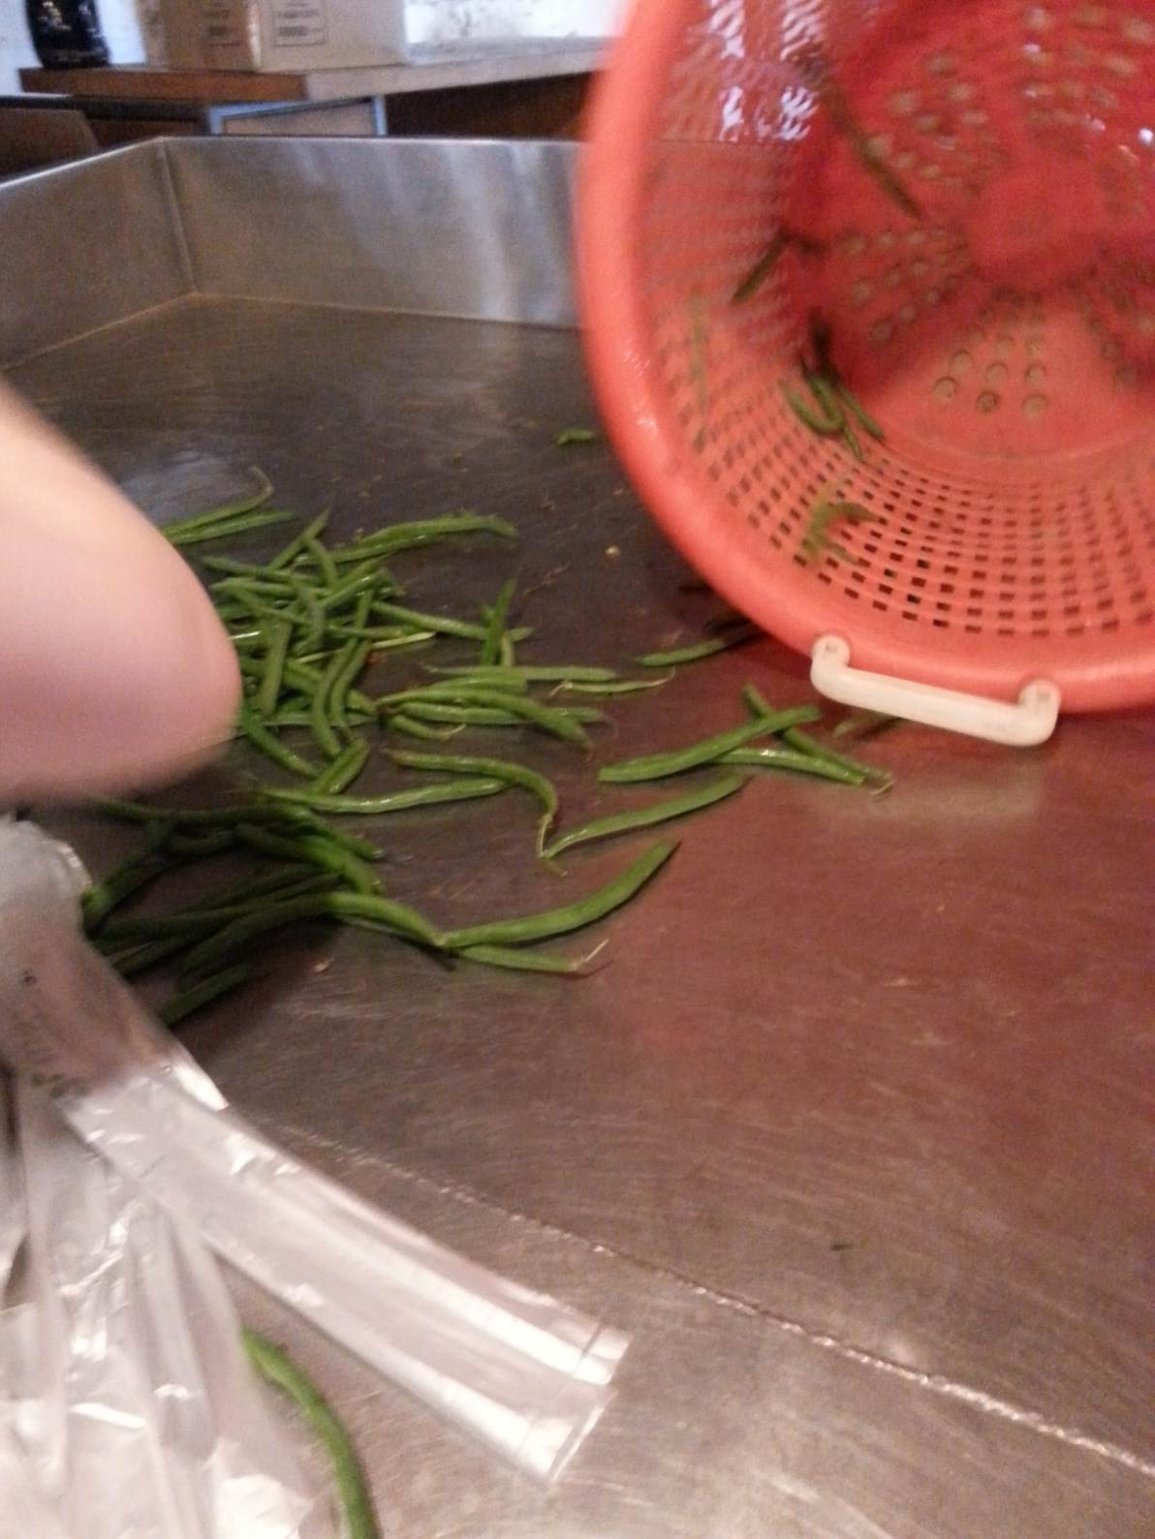
Notes:
Packing tables, lines, moveable belts should be cleaned daily when they are in use. Cleaning and sanitizing with an approved food surface sanitizer, following the label instructions and restricting the surface from any other use other than packing is important. A sanitized surface can become contaminated when workers use it as a break area, a storage location for clothing and bags, and if wild or domestic animals come in contact with it.

Slide 17
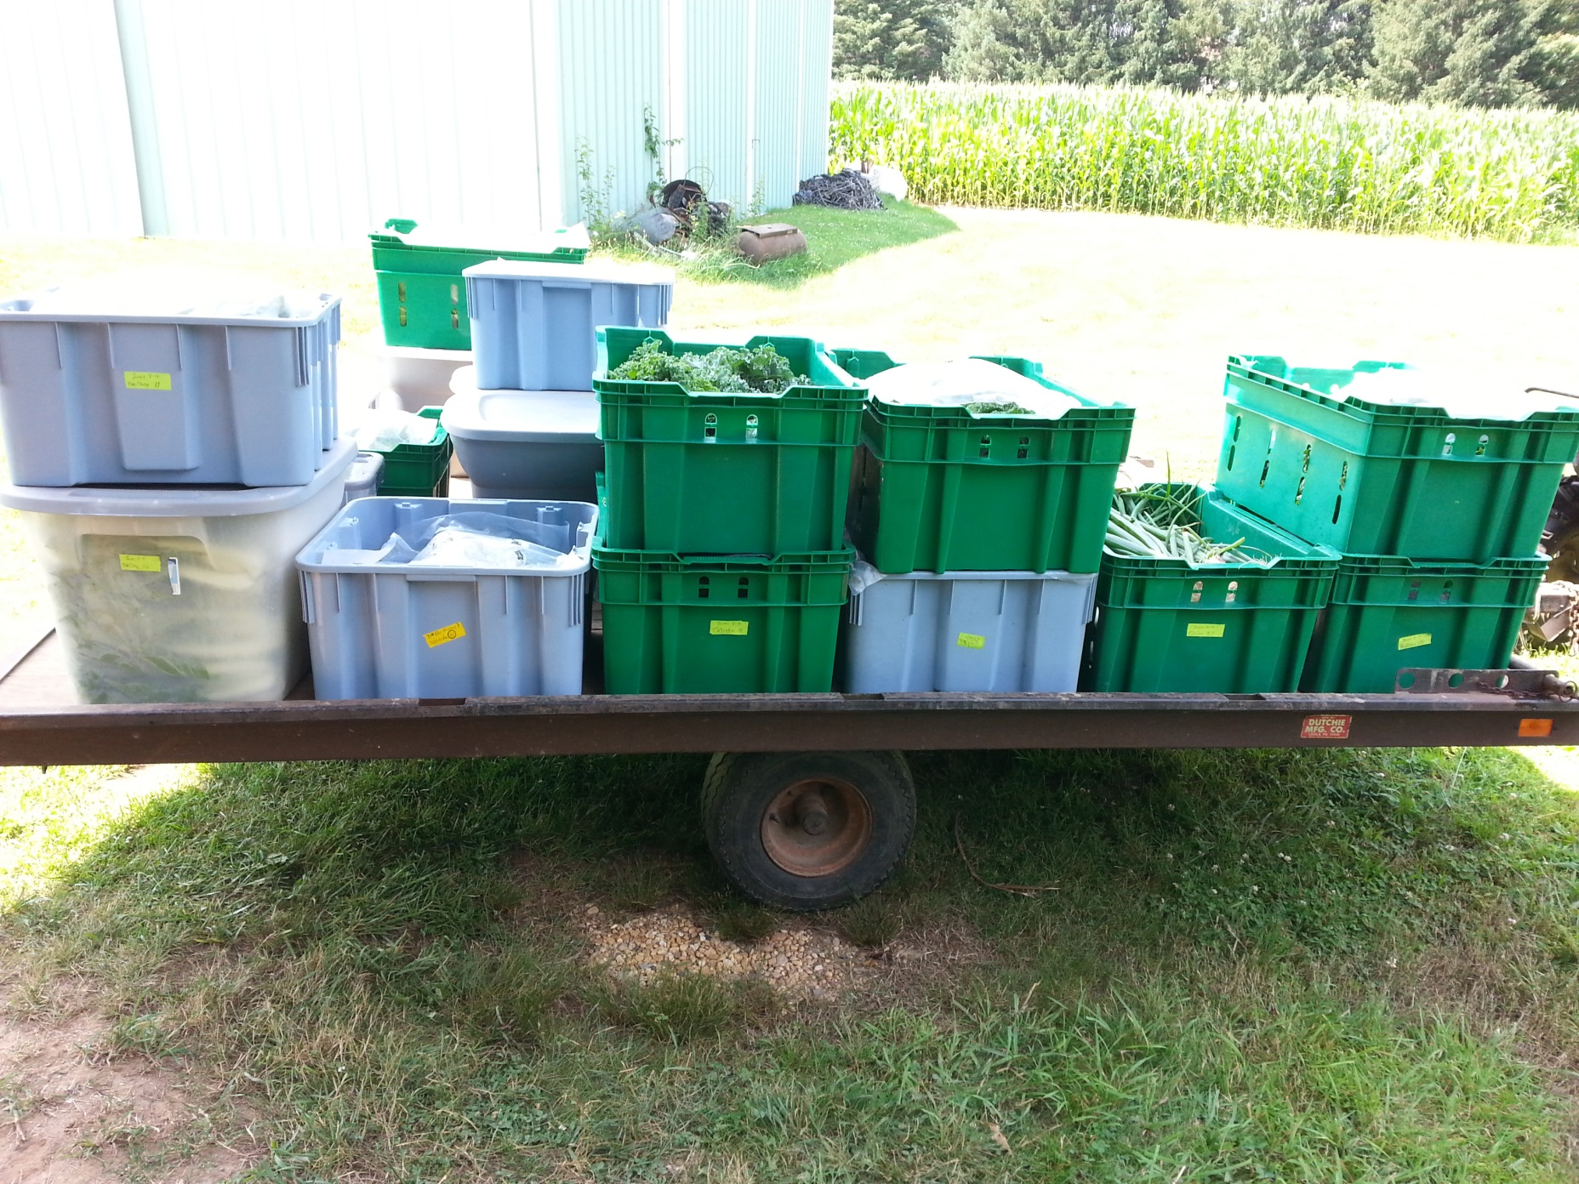
Notes:
Containers used for storage of produce, or transport to market locations also needs to be cleanable materials. Storage areas should have a rodent control program to prevent contamination of the containers when in use and when stored for later use.

Slide 18
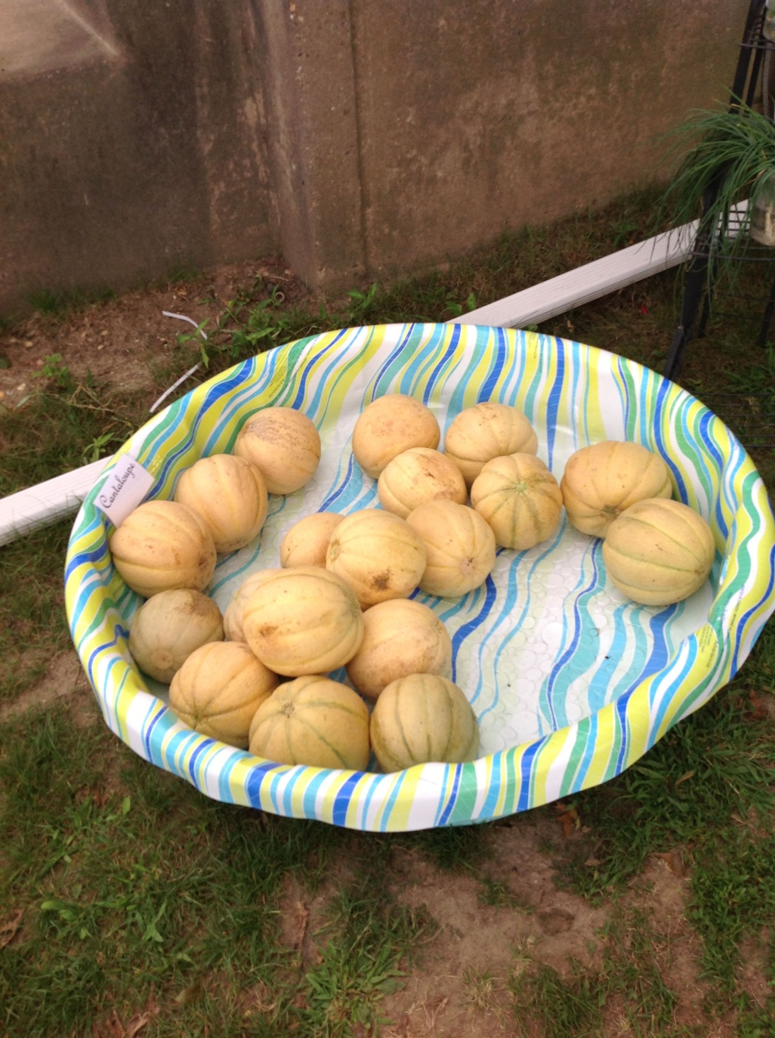
Notes:
Repurposing containers is OK, but make sure they are cleaned appropriately before use. Use common sense and go with your gut!

Slide 19
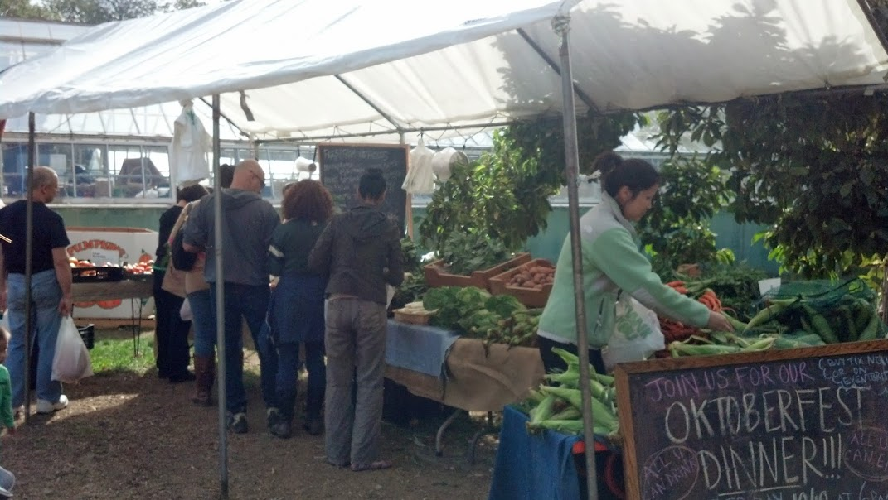
Notes:
Sales displays like burlap should not come in contact with produce directly, but can still be used for displays. Burlap and wood cannot be sanitized. Any cloth items used should be machine washed and dried in a machine drier.

Slide 20
Notes:
Customers are often brining their own bags to markets to shop, and while this is great for recycling and reducing plastic waste it also comes with risks. Consumers should understand that food safety is important at the farm, the hoops you jump through to ensure a safe quality product, and that they have the potential to contaminate produce themselves. HANDOUT FOR CONSUMERS. The consumer should take care to reuse bags that they know have not had meat, eggs or other questionable items in them. Sturdy reusable bags should be run through a wash and dry cycle regularly.

Slide 21
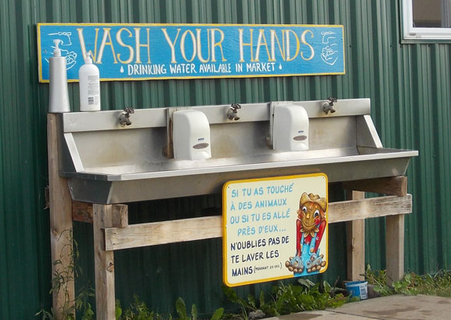
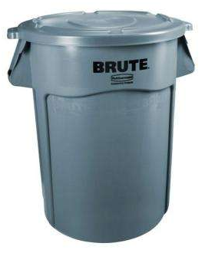
Notes:
Customers are often brining their own bags to markets to shop, and while this is great for recycling and reducing plastic waste it also comes with risks. Consumers should understand that food safety is important at the farm, the hoops you jump through to ensure a safe quality product, and that they have the potential to contaminate produce themselves. HANDOUT FOR CONSUMERS. The consumer should take care to reuse bags that they know have not had meat, eggs or other questionable items in them. Sturdy reusable bags should be run through a wash and dry cycle regularly.

Slide 22
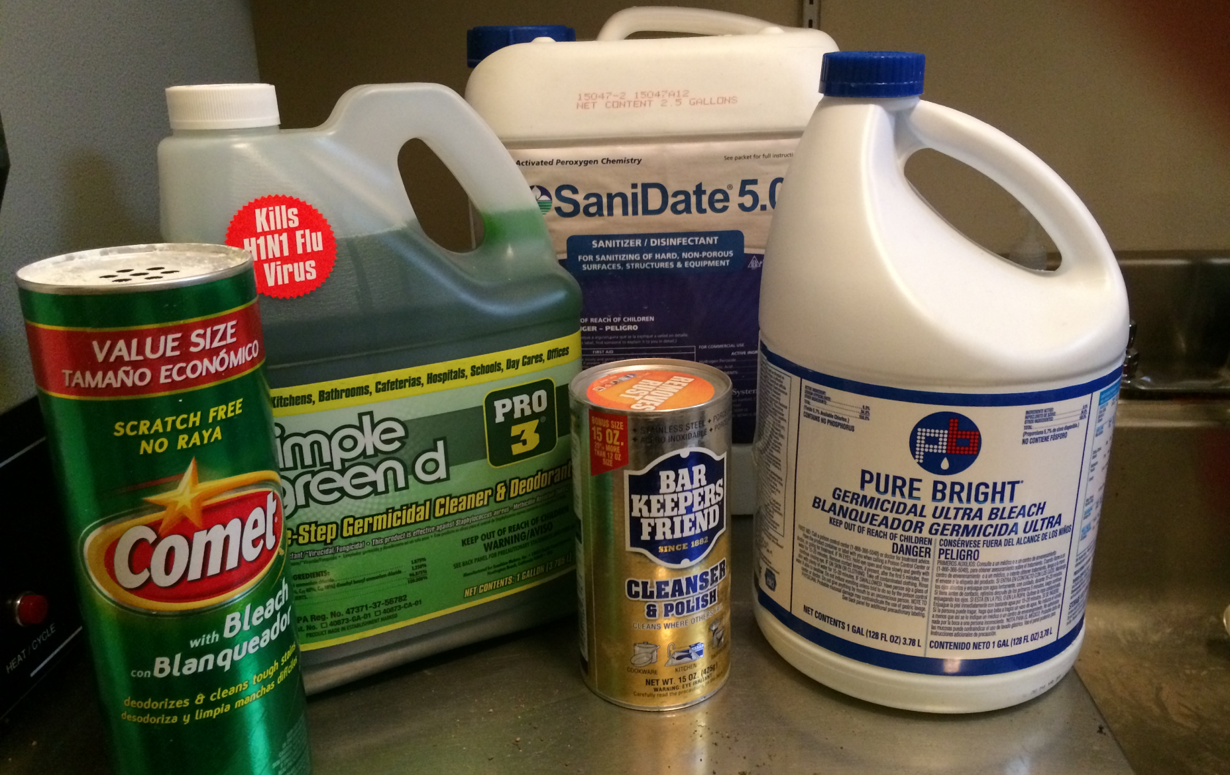
What cleaner and sanitizer to use?
Notes:
There are many types of cleaners and sanitizers available on the market. Regardless of what you choose be sure to read the label prior to making a decision.

Slide 23
What cleaner and sanitizer to use?
Does it kill pathogens prevalent in foodborne illness outbreaks? Salmonella, E. coli, Listeria…
Is the produce approved for use on food-contact surfaces?
Is the product certified by the EPA?
Is the product compatible with the surfaces you intend to use it on?
How quickly does it kill these pathogens?
Will the surface remain wet long enough to meet the required kill time?
How many steps are involved in the cleaning and sanitizing process?
What are the water requirements for use?
Notes:
Water temperature may need to be adjusted for use, the water may need a specific pH in order to be effective, and minerals in water can impact efficacy. Chlorine is most effective at a pH between 6.0 and 7.5. Test strips to monitor pH and chlorine concentration should be used. The “smell test” is not effective!
Hydrogen peroxide (Sanidate/Tsunami)

Slide 24
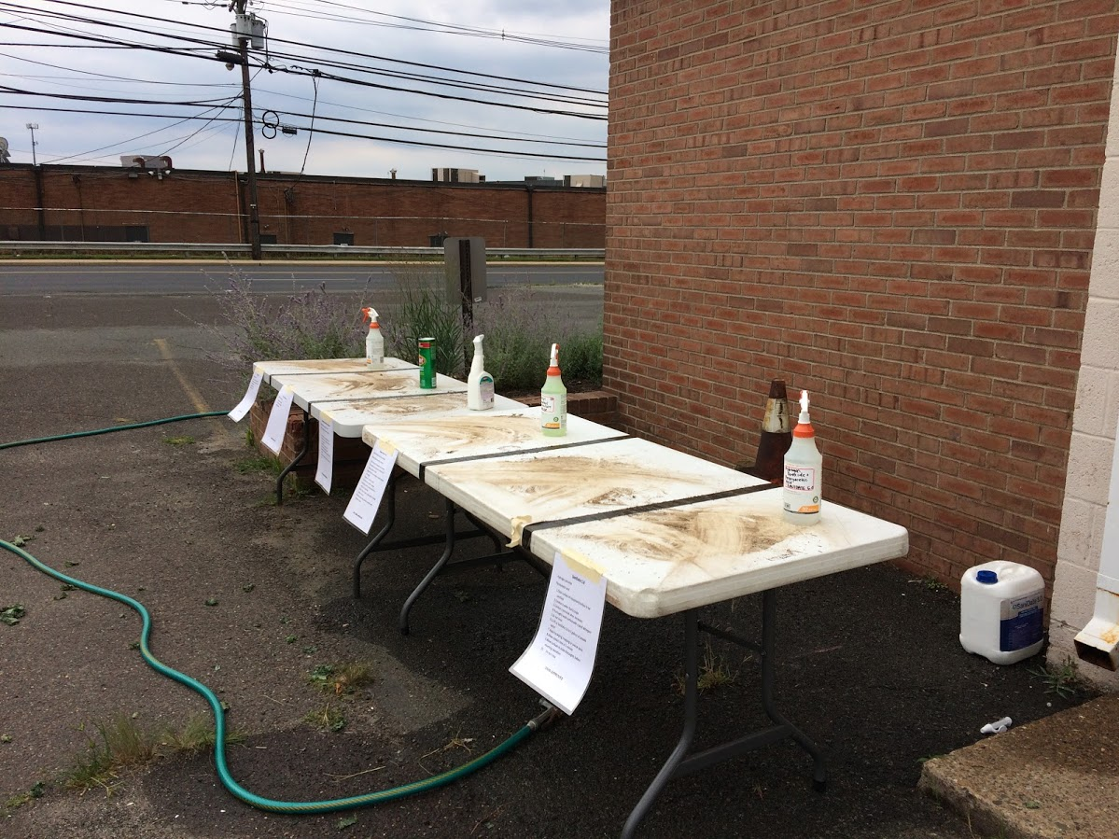
Notes:
We tested out several sanitizers and cleansers against using just water. The tables were smeared with a leafy green and soil mix. An ATP detection meter was used to evaluate the table when it was dirty. The tables were then cleaned with a scrub brush and the label recommended cleaner and then sanitized according to the label directions. Once cleaned and/or sanitized the ATP was evaluated again to determine the effectiveness of the cleaning and/or sanitizing. All products were effective when the directions were followed. When the directions were not followed the ATP levels did not fall as expected. Just water and a scrub brush made the table look clean but there were still high levels of ATP found on the surface.

Slide 25
How to clean and sanitize?
Notes:
Chose an effective sanitizer that is labeled for food contact surfaces and has an EPA registration number.
Develop Standard Operating Procedures (SOP) for the sanitation step of product contact surfaces.

Slide 26
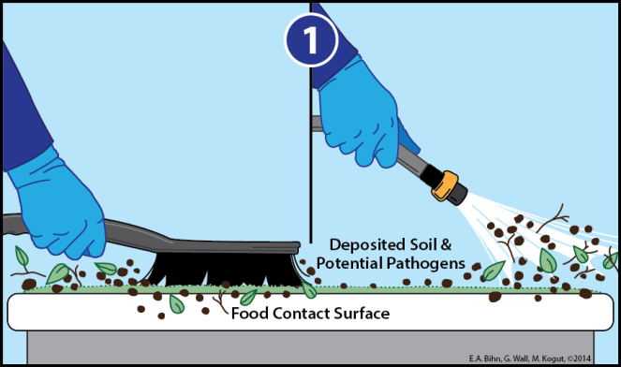
How to clean and sanitize? 1. Remove any obvious dirt and debris from the food contact surface.
Notes:
1. Remove any obvious dirt and debris from the food contact surface.

Slide 27
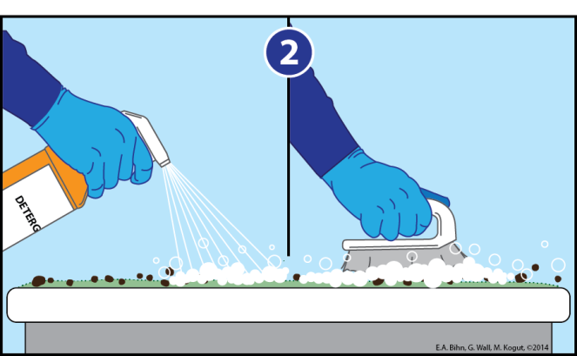
How to clean and sanitize? 2. Apply an appropriate detergent and scrub the surface.
Notes:
2. Apply an appropriate detergent and scrub the surface.

Slide 28
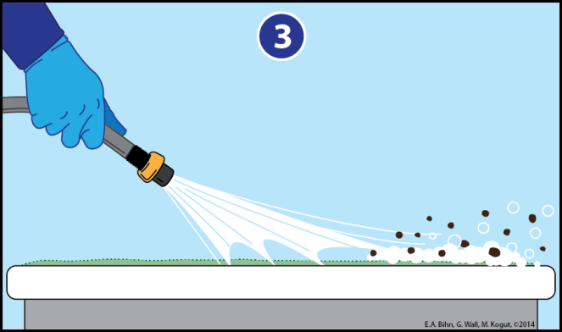
How to clean and sanitize? 3. Rinse the surface with clean water, making sure to remove all of the detergent and soil.
Notes:
3. Rinse the surface with clean water, making sure to remove all of the detergent and soil.

Slide 29
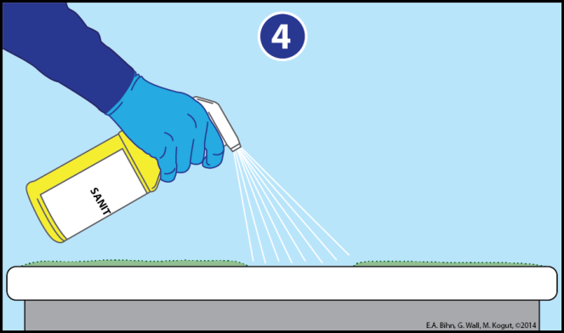
How to clean and sanitize? 4. Apply a sanitizer approved for use on food contact surfaces. Rinsing may be necessary. Let the surface air dry.
Notes:
4. Apply a sanitizer approved for use on food contact surfaces. Rinsing may be necessary. Let the surface air dry

Slide 30
What is a Standard Operating Procedure?
Writing Your SOPs
Written instructions to achieve uniformity of the performance of a specific task or function
Step-by-step information on how to execute a task
A prescribed procedure to be followed routinely
Notes:
Written instructions to achieve uniformity of the performance of a specific task or function
Step-by-step information on how to execute a task
A prescribed procedure to be followed routinely

Slide 31
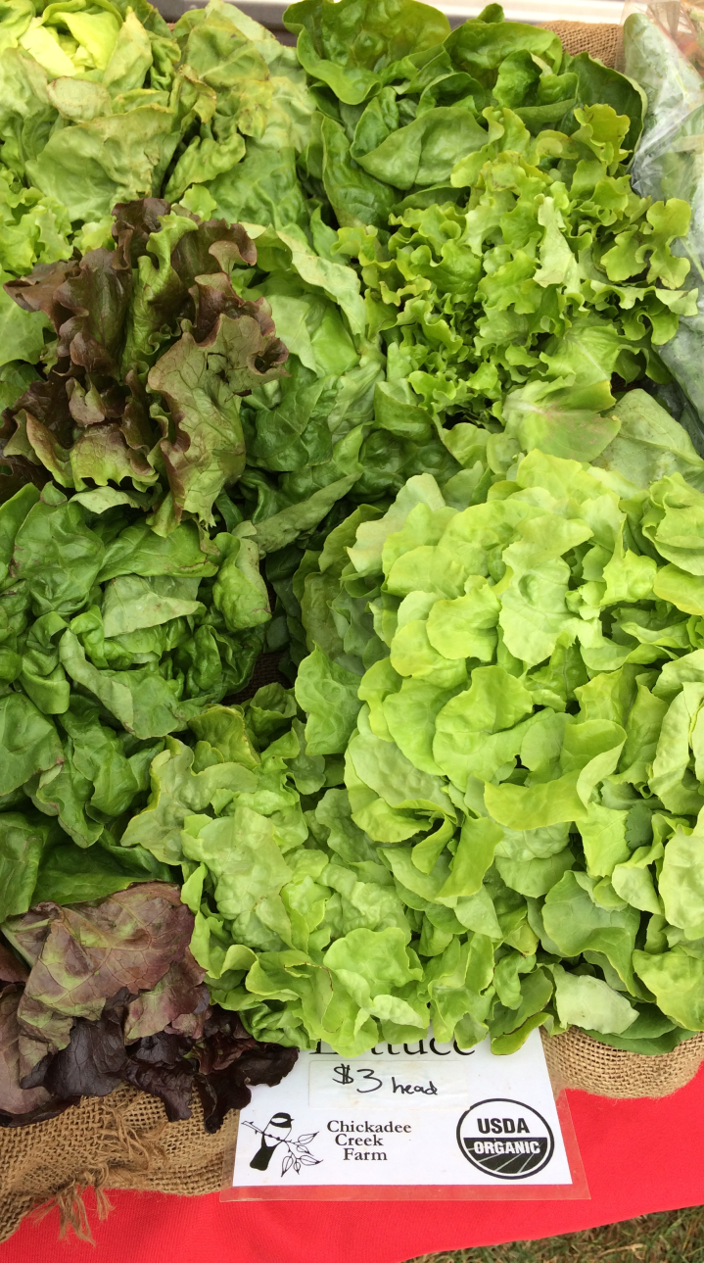
Writing Your SOPs
Before you write your SOP
Identify the flow of
product through the
packing process
2. Identify the biggest
potential risks for product
contamination
Notes:
The development of an effective SOP (standard operating procedure) is critical to the success and use of that SOP.
Identify the flow of
product through the
packing process
2. Identify the biggest
potential risks for product
contamination

Slide 32
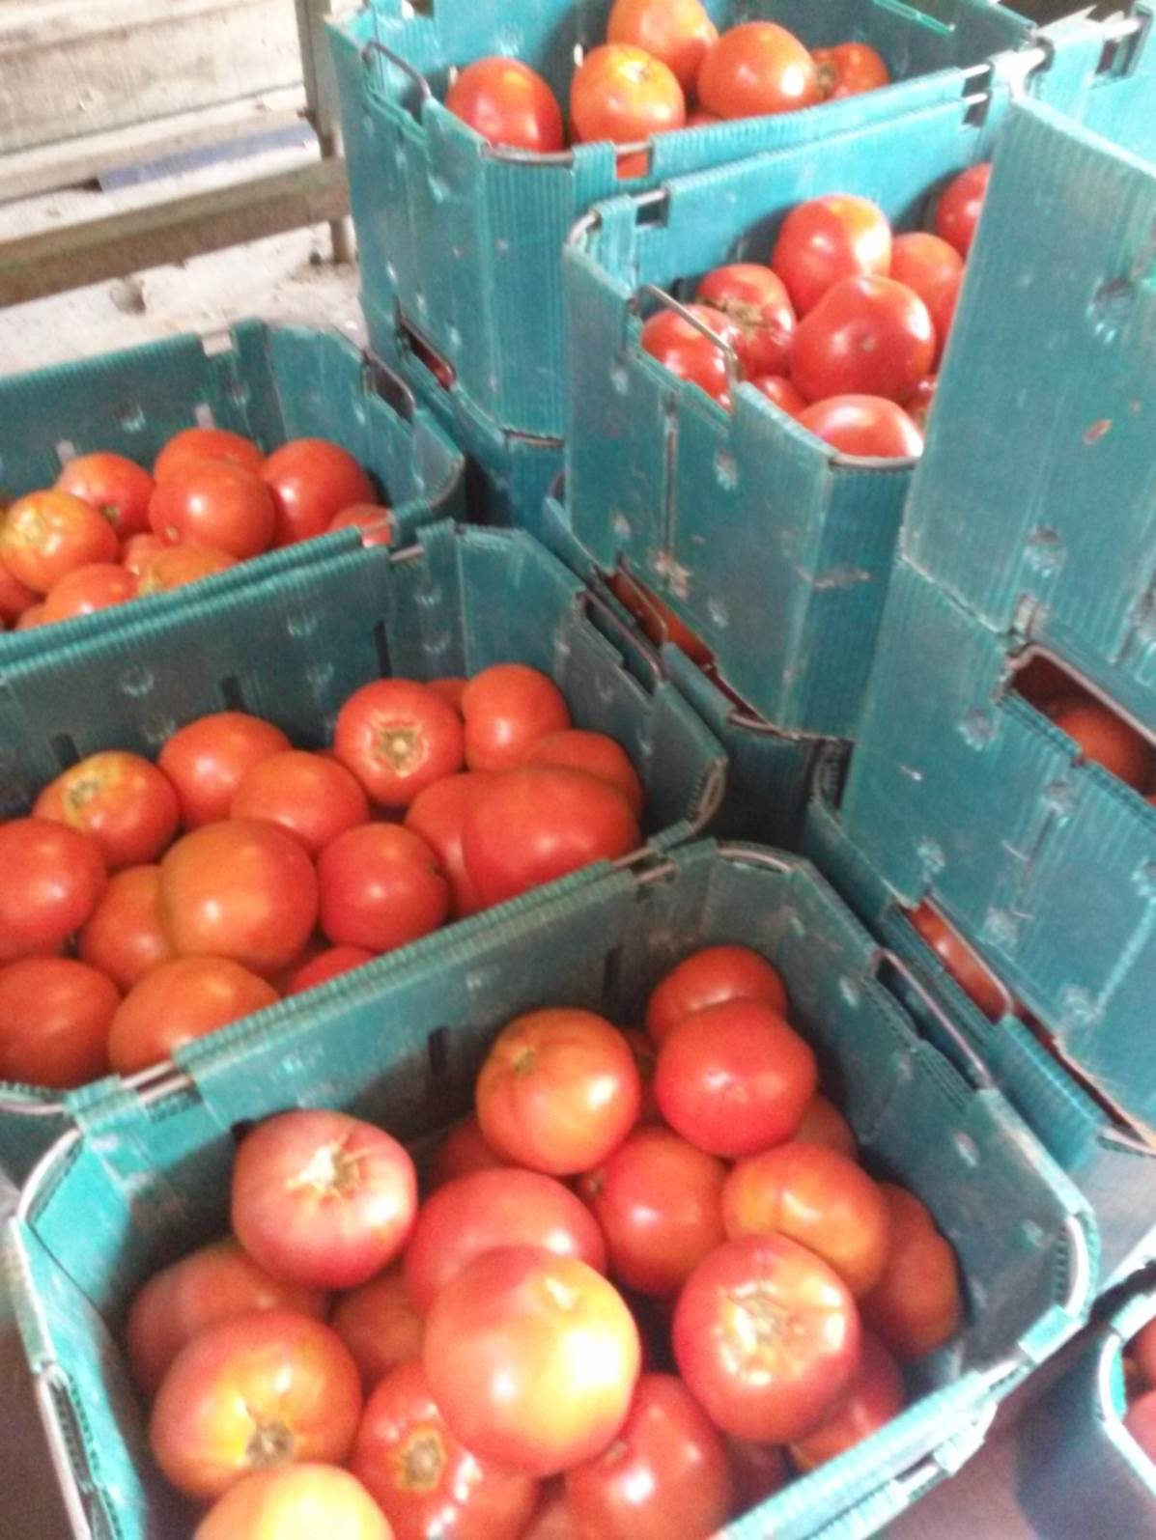
Writing Your SOPs
Well written SOP’s
Provide direction
Improve communication
Reduce training time
Improve work consistency
Goal
create a document that is easy
for workers to understand
Helpful!
Notes:
Well written SOP’s
Provide direction
Improve communication
Reduce training time
Improve work consistency
Goal
create a document that is easy
for workers to understand
Helpful!

Slide 33
Questions

